Slide 1
Seed Management: Natural Farming
Master Trainers Training MANAGE 5-9 April 2022
-Dr KS Varaprasad
Sr Consultant, RRA N & RySS

Slide 2
Categories of Cultivars/ Seeds
BDA: Farmer varieties: Landraces, Ethnic, Traditional, Heritage
PPVFRA: New, Essentially Derived, Extant, Farmer
Seed Act: Notified and Released varieties: Improved, Hybrids (several types), GMOs
Seed Chain: Nucleus, Breeder, Foundation, Certified, Truthfully Labeled
Farmers’ Rights on Seeds: BDA (CBD), PPVFRA (UPOV), MLS (ITPGRFA)
DBT GL (CPB)

Slide 3
Rainfed areas contribution
Food grains- 40%
livestock population- two-third
Rice- 44%
Minor millets- 90%
Coarse cereals (sorghum, pearl millet, maize)- 87%
Food legumes- 85%
Oilseeds- 72%
Cotton- 65%
Critical to food security, equity, and sustainability.

Slide 4
Varieties- Relevant Act (s)
Farmer Varieties (FV)/Landraces (LR)
Agric Scientists from Public and private sectors: All breeding or improvement approaches including genetically modified methods (transgenics). ;GMOs have to go through IBSC, RCGM and GEAC approvals
Farmers: Can develop a new variety by selection, crossing or hybridization. No GMOs from farmers
FVs and LRs are not considered as new varieties

Slide 5
Identification Process..
SVRC: Provinces or States can decide their own approach to identify new variety.
Yield, quality and pest resistance traits are considered. Release may be for the entire state or select agro ecological zones. State notifies the new varieties identified in each crop.
CVRC: AICRP guidelines for testing and identification (crop-wise) available in public domain. New Variety identified by the Committee will be notified through a gazette notification.

Slide 6
..Identification Process
SVRC to CVRC: Proposal submitted by SVRC with one year testing as per AICRP guidelines to release and notify by the CVRC.
Private seed industry: Independent mechanism in place
Farmer Variety: In PPVFRA, have to pass through DUS testing. Some standards relaxed.
Ownership certificate is issued to the applicant (s) \
Mainstreaming Landrace or Farmer Variety that is not registered with PPVFRA: Alternative Seed System as proposed in OMM under No ownership and remain in pubic domain

Slide 7
Release and Maintenance..
All notified varieties quality parameters are monitored under Seed Act 1966 - punishable offences under the Act.
Varieties released by Private Industry have to be registered with the State Govts for sale- declare the performance under defined conditions.
Farmer Varieties or Landraces can be multiplied and distributed free of cost or at a cost by the State Govts under different schemes of central or state Govts.
Genetic purity and other trait standards maintenance is the responsibility of the breeder or institute that releases through CVRC or SVRC.

Slide 8
..Release and Maintenance
Private Industry releases commercialized are responsible and the state govt may impose penalties for non performance of declared traits.
No standards for FVs or LRs are verified or monitored except as proposed and pilot testing in OMM

Slide 9
Sales and Promotion
Commercial sale with labelling; Ownership as per release records
Farmers: Free to cultivate and share at a cost with other farmers without any branding or labelling
Ownership for only FVs registered with PPVFRA
All other FVs and LRs will remain in the public domain
Any farmer or scientist can register for a unique trait or traits with ICAR-NBPGR Germplasm Registration Mechanism
NGOs/ FAs/ FNs NBPGR/ Central Schemes may promote through different schemes for cultivation of FVs and LRs

Slide 10
Marketing and Monitoring
Marketing is regulated for unauthorized (unregistered) sales in the State
All notified varieties are liable to be monitored under the Seed Act 1966. Registered owners have rights to complain against misuse or sale.
FVs / LRs: No monitoring mechanism for seed quality and standards

Slide 11
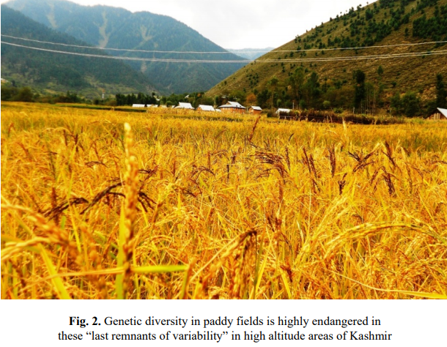
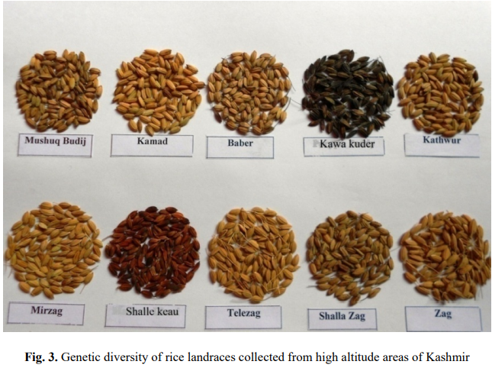
Rice Landraces From High Altitude Areas

Slide 12
Rice Landraces From Different Parts of India
State | Landraces | Special remarks
Himachal Pradesh | Chuhartu Karad Sukara Katheri Begumi Kalafulpatash Lal Basmati Himtu Bohana dhan Jhini Ramjawain Rangdi | Red aleurone Red aleurone, field resistant to disease and insects, drought tolerant, karad means very hardy and luxuriant, white awn, Red aleurone Red aleurone, aromatic, sweet, sticky rice, given to women after delivery as it is considered to restore certain internal reproductive body parts to normalcy, semi-spreading plant type, purple hull, pink awn Red aleurone, aromatic, long, fine grains Aromatic, sweet grains, high swelling upon cooking, field resistant to diseases, glumes tip black, blackish purple stem Aromatic, slightly red, long grains, high yield, orange-red hull Sweet, slender fine grains, very early maturing, dwarf, lodging resistant Bold grains, high yield Sweet, bold, brownish grains Sweet, long and fine grains Cold tolerant, small and fine grains, non-sticky, good yield

Slide 13
Rice Landraces From Different Parts of India
State | Landraces | Special remarks
Jammu and Kashmir | Mirzag Mushk Budji | Red aleurone, early maturing, high yield, better milling recovery, tolerant to lodging Red aleurone, bold and fine grains, cooks very good, the most popular scented rice of Kashmir valley, very costly, cooked in feasts only by rich people
Andhra Pradesh | Chitti Muthyalu Ragalvanji | Aromatic, sweet, small and non-glutinous, white grains (chitti = tiny, muthyalu = pearl), landrace is in verge of extinction Non glutinous rice especially used in religious purpose, landrace is in verge of extinction

Slide 14
Example: Rainfed Rice Ecosystem and Varieties
Ecosystem | Old varieties | New Varieties
Rainfed upland very early (up to 70 DF) | Heera Vandana Aditya | Kalakeri Cauvery
Rainfed upland early (71–80 DF) | Annada Tulasi Narendra 97 | Waikoku Rasi/Fine Gora Ratna
Rainfed shallow lowland (>110 DF) | Dhanrasi Swarna Salivahana | O. Rufipogon Vasistha/Mahsuri Pankaj
Rainfed (late) (>110 DF) | Savithri Swarna | Pankaj/Jagannath Vasistha/Mahsuri

Slide 15
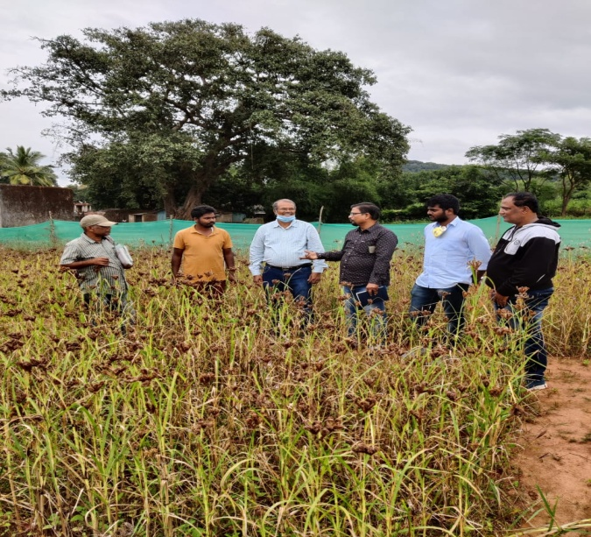
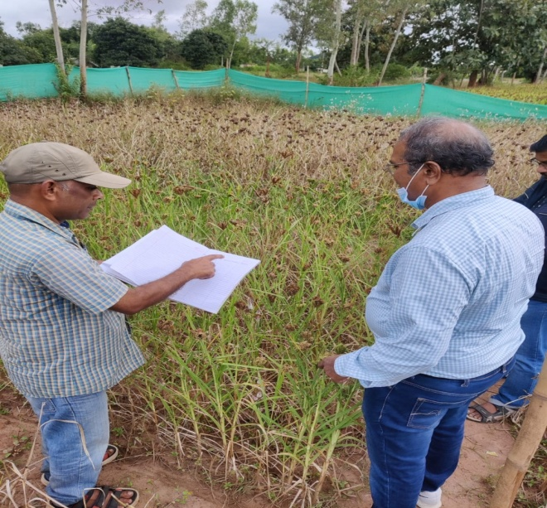
Status of Multi-locational trial in ragi – 2021-22 (Kharif)
Late vegetative, panicle initiation, flowering, Physiological maturity and harvesting data collection is in progress will complete – 10.11.2021
Visit of Dr. Varaprasad (Chairman of Seed working group) and IIMR scientists to Koraput and Malkangiri – 09.11.2021 to 13.11.2021

Slide 16
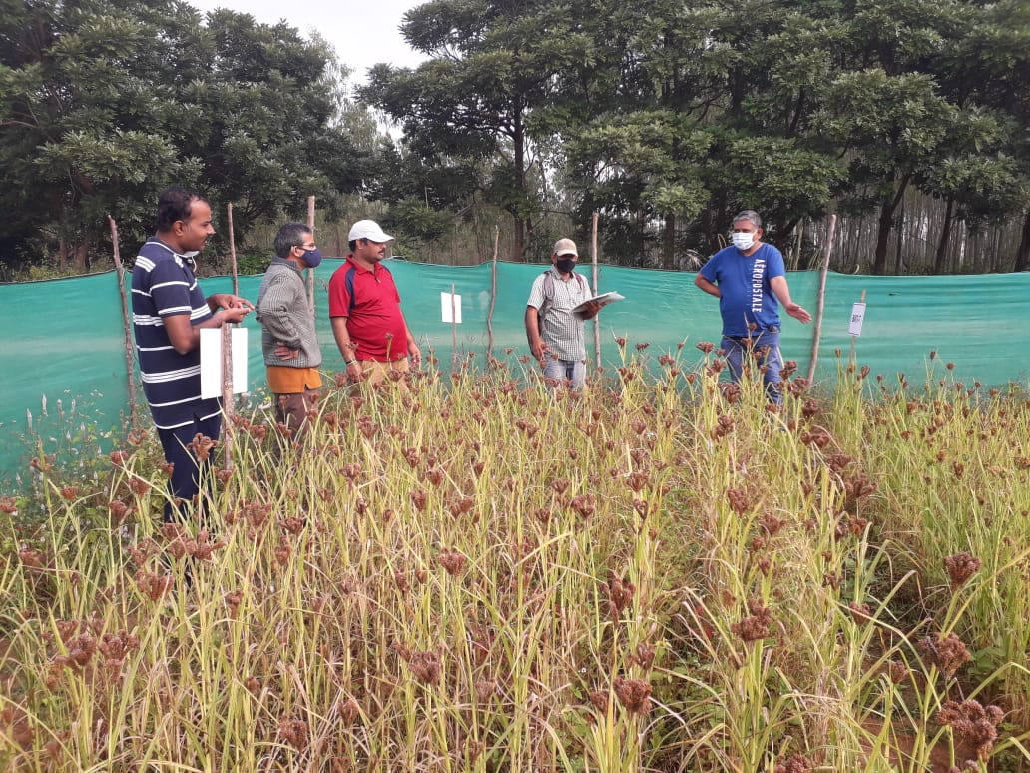
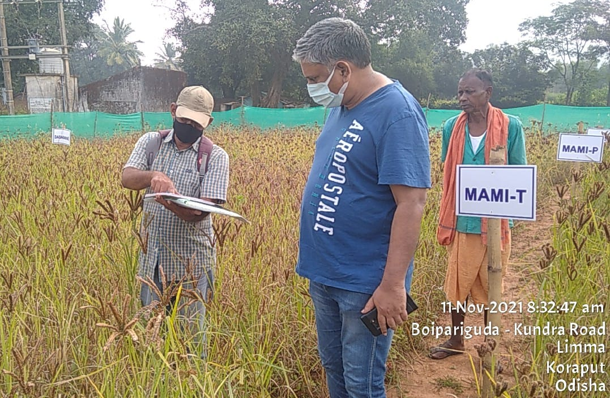
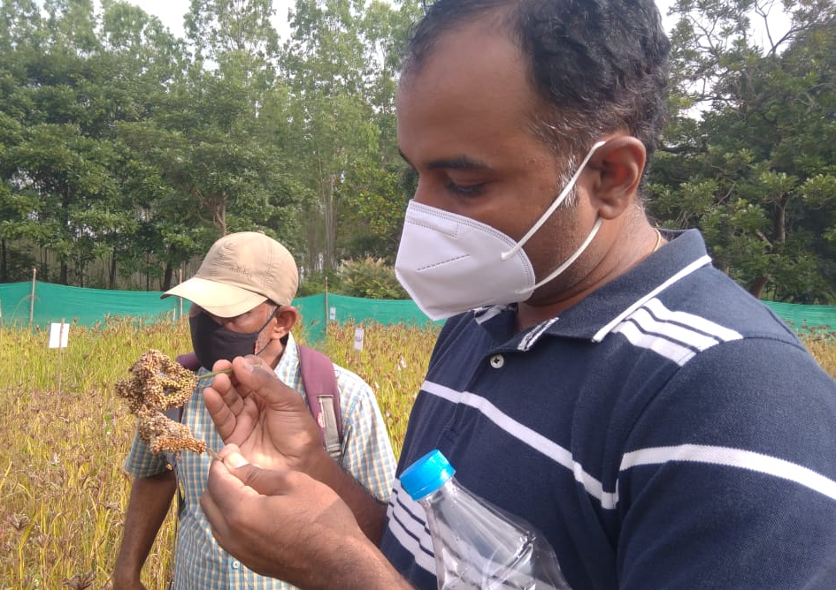
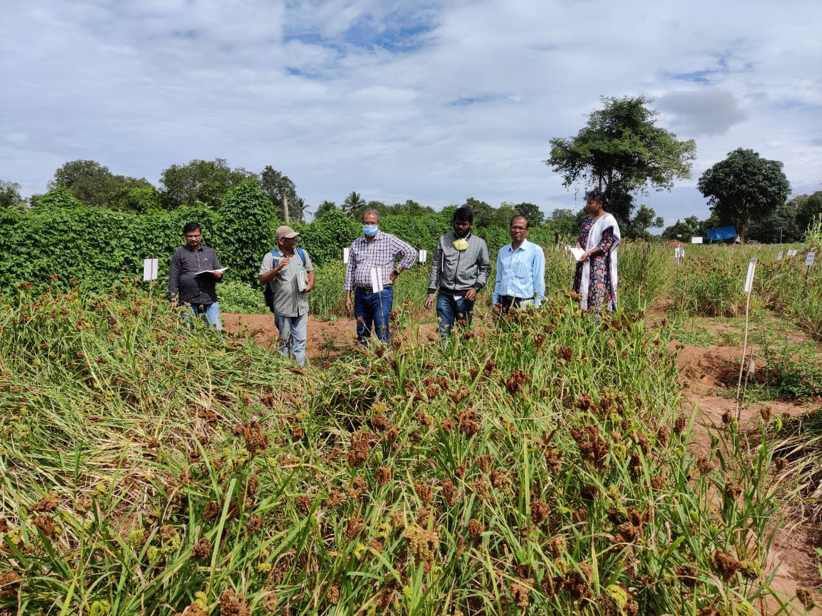

Slide 17
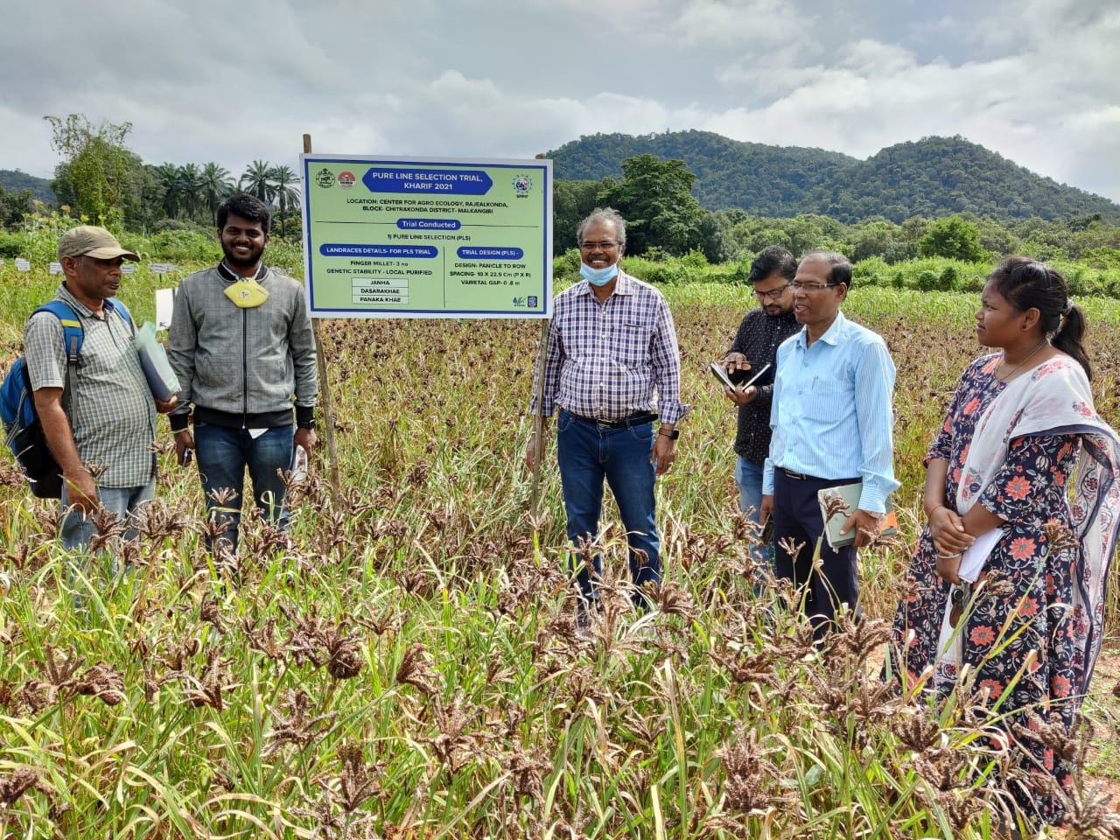
Kharif Trail

Slide 18
Germplasm, landraces, traditional varieties, farmer varieties | Websites/ Databases | Crop based ICAR institutes
Germplasm | Websites/ Databases/ Genebanks | SAUs
Landraces, varieties | Community Seed Banks | Farmer Organisations
Information with or without named varieties | Oral or TK documents/ Published / Ancient Literature | Custodian farmers /TKDL/ Publications
Germplasm, landraces, traditional varieties, farmer varieties | Websites/ Databases | Crop based ICAR institutes

Slide 19
Seed Value Chain

Slide 20
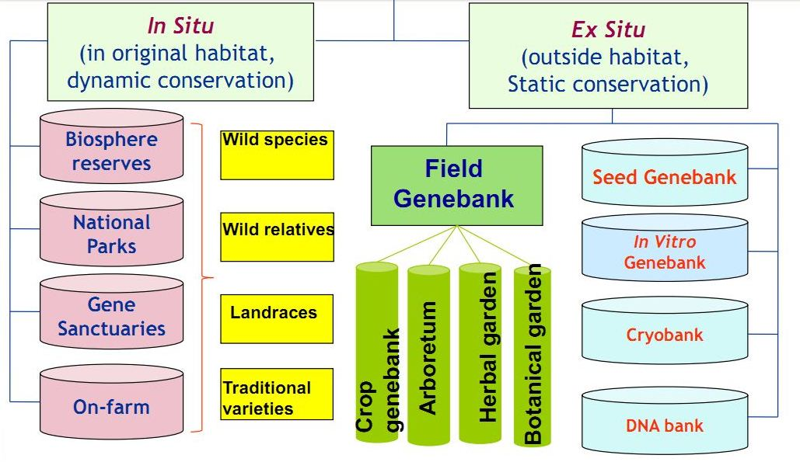
Strategies for Conservation of Bioresources

Slide 21
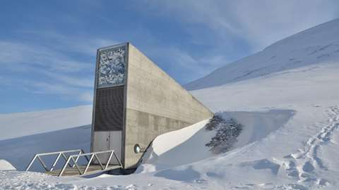
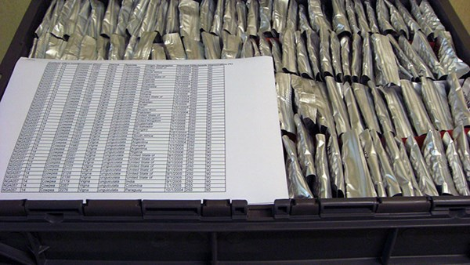
Material in the SVALBARD GLOBAL SEED VAULT
Countries: 243
Genera: 1,091
Species: 6,005
Accessions: 9,83,524
Indian Origin Taxa:524
Accessions:73,241
World Status on Gene Banks
1750 Gene banks
100 Countries
>7.4 million seed samples conserved

Slide 22
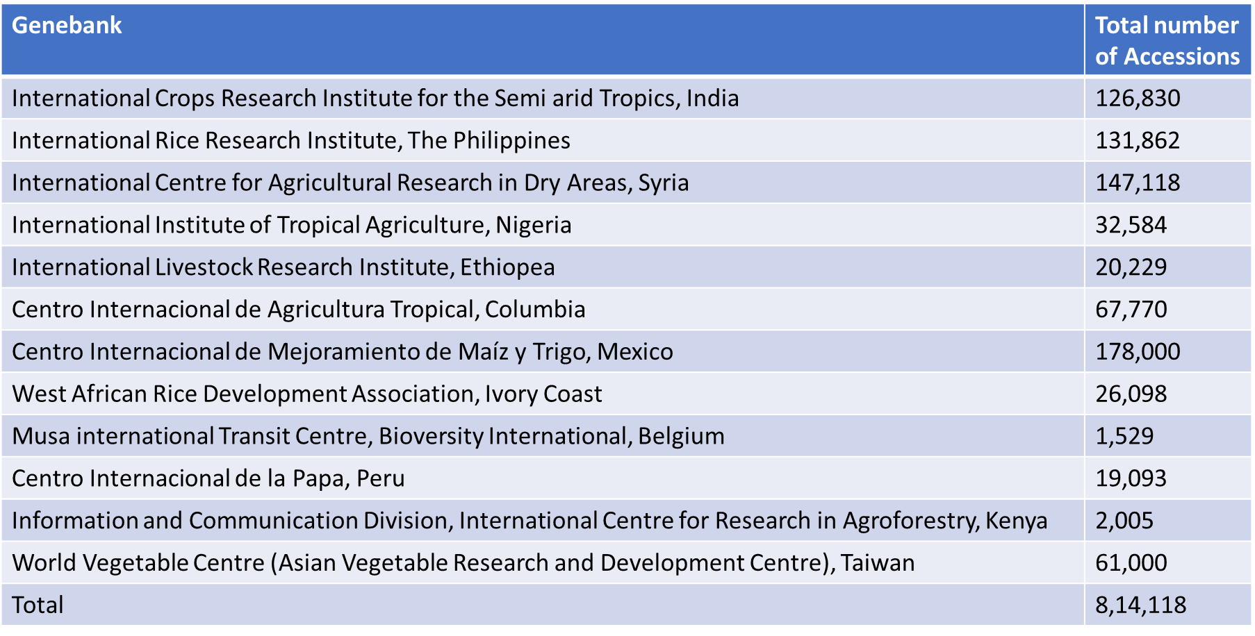
CGIAR & International Research Centre Germplasm holdings

Slide 23
Key Process Outlined in SOP of Seed System for Landraces ..
Standardizing landraces documentation Characters – Minimal descriptors
Landrace Varietal Evaluation – To release Yield/Pest resistance/Nutritional value/Climate resilience/Minimal chemical inputs
Crop/Seed standards and Certification guidelines for landraces
Package of practices (PoP) for seed production of landraces

Slide 24
.. Key Process Outlined in SOP of Seed System for Landraces
Landraces Release & Notification by Apex Committee under APC cum ACS/Secretary DAFE
National Approval (CVRC) – Apex committee facilitate to CVRC
Capacity Building of WSHGs/FPOs on Quality seed production
Seed production & certification through WSHGs/FPOs under guidance of OSSC/OSSOPCA

Slide 25
Standard Operating Protocols (SoP) for Landraces
The Standard Operating Protocols (SoP) for Supportive Seed Systems for Landraces to be managed though communities is developed after wider national and state level consultations and review of various field experiences
Mainstream the important landraces and facilitate quality seed access to the farmers with the involvement of existing formal (public) and informal (NGO/ CSOs/ farmer networks) institutional infrastructure available locally.
There will be no exclusive rights to any individual or groups on such mainstreamed landraces. Information on such landraces can be accessed through an Open Digital Seed Platform.

Slide 26
Institutional Arrangements (for the state of Odisha):
A State level APEX COMMITTEE
Supportive Seed System for Landraces (SSSL) will be constituted by Government headed by the Agriculture Production Commissioner cum Additional Chief Secretary/Principal Secretary, with members drawn from Line departments, OSBB, PPV&FRA, ICAR-IIMR, OUAT, SSTL, OSSOPCA, OSSC, NCDS, WASSAN, FAO, CSOs/ NGOs, Custodian farmers, Experts and others decided by the Govt of Odisha.
Committee will consider promising landraces having good cooking quality, medicinal value, salinity resistant, flood resistant, scented variety etc.,
Apex Committee can set up Sub-Committees from time to time for various purposes.

Slide 27
A Landrace Varietal Sub-Committee (LVSC)
Develop standards, certification protocols
Scrutinizes applications for release of landraces.
Mainstreams landraces on par with CVRC/SVRC and PPV&FRA.
No exclusive rights - continue to be in public domain

Slide 28
Odisha State Seed and Organic Products
Certification Agency
Seed certification as per standards approved through participatory process.
Select para-seed certifiers and provide training through OSSOPCA
Capacity building of farmer collectives/FPOs.
Monitor landrace production by the FCs/ FPOs.
Certification manual developed.

Slide 29
The Genebank at the State Seed Testing Laboratory
Conservation of baseline collections and samples of multiplied/evaluated with data -to CDBs
Reference bank for all landraces.
In-situ conservation of landraces
The open source digital landrace repository
It will also facilitate nutritional profiling and DNA fingerprinting
It will be supported by adequate budgets for the same.

Slide 30
Institutional Arrangement
Supply of source seed on demand.
Provide technical oversight on the production programs and maintenance breeding.
Package of practices (POP) s in association with expert NGOs (MSSRF, SAMBHAV, WASSAN, RRA Network, etc) / FPO that has traditional knowledge to contribute in developing POP.
Seed and field standards be revised as per need in association with ICAR-IISR
Pilot study to map the institutional infrastructure appropriately

Slide 31
Open Source Digital Platform for Landraces
All the data related to landraces and operations will be managed through an open source digital platform
These platform functionalities will be further developed by a Working Group

Slide 32
Landrace Seed Centres
FPOs at Block level to get registered for to enhance quality seed supply CSBs
FPOs should have interest and experience in seed business.
Para Seed Certifiers who will be trained and support the latter in certification of landraces.
The FPOs will be technically supported by CSOs/ NGOs for the initial period.

Slide 33
Establishing Biodiversity Blocks
Melas, Fairs, local markets - Local needs and demand
Prioritise crops and landraces
Seed and Field Standards of Landraces
Isolation distance and reproductive system
Genetic Purity - Principal trait
Biodiversity Blocks - Farmer visits - selection
Research and Innovation
Local production and local consumption

Slide 34
Conclusion: Farmer Seed Sovereignty
Promote Landraces for Inclusiveness, Equity and Sustainability
Adapt Alternative Seed System
Develop critical mass of para seed certifiers
Local Production and local consumption

Slide 35
Thankyou

